Slide 1
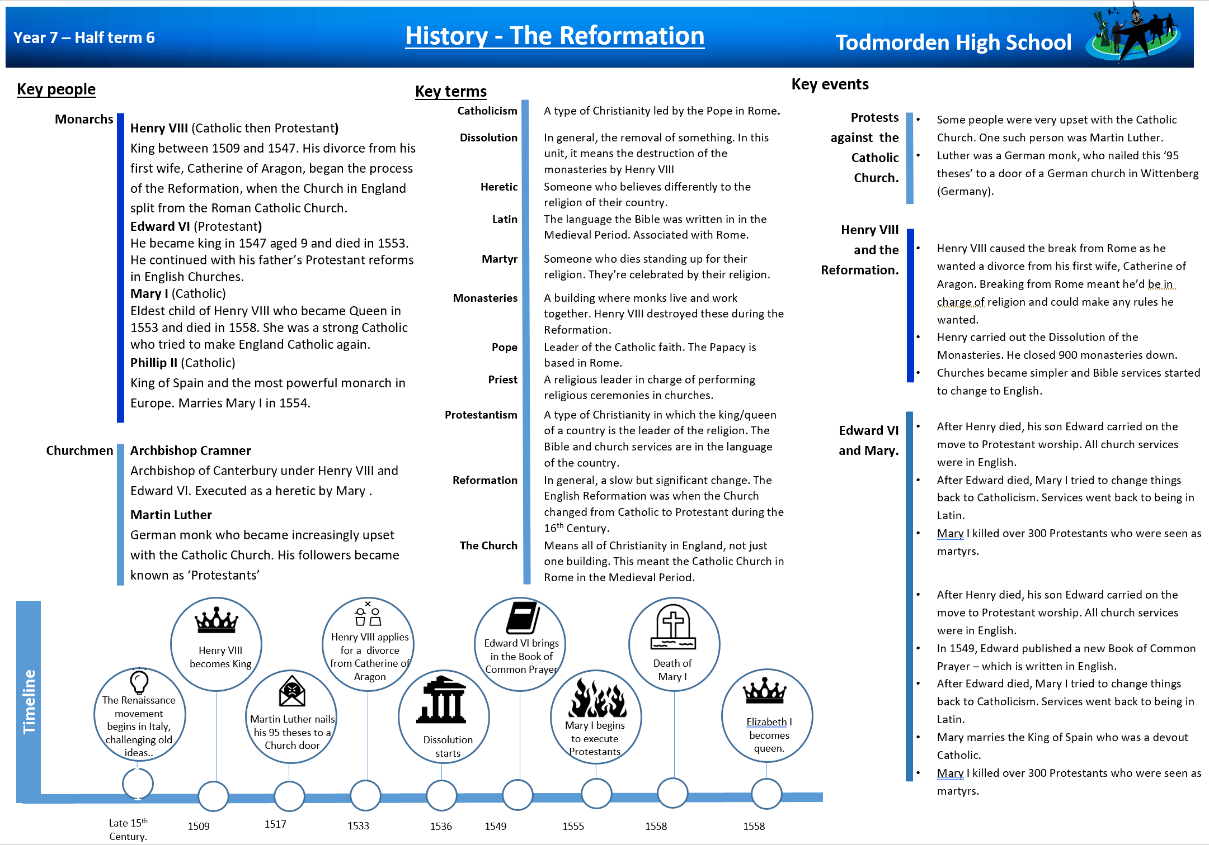
Knowledge Organiser: Year 7 The Tudors

