Slide 1




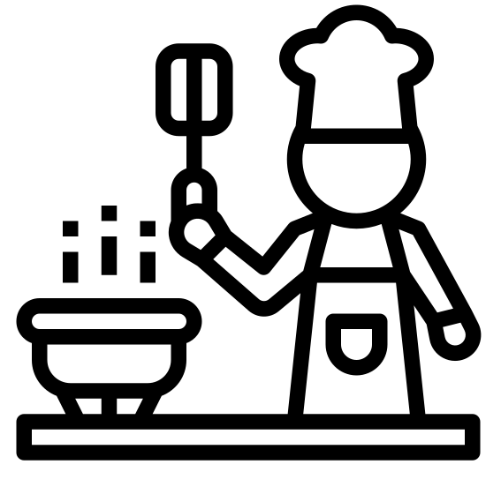





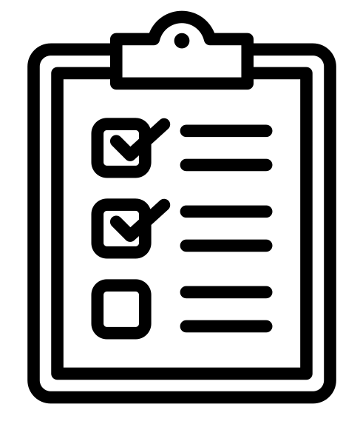



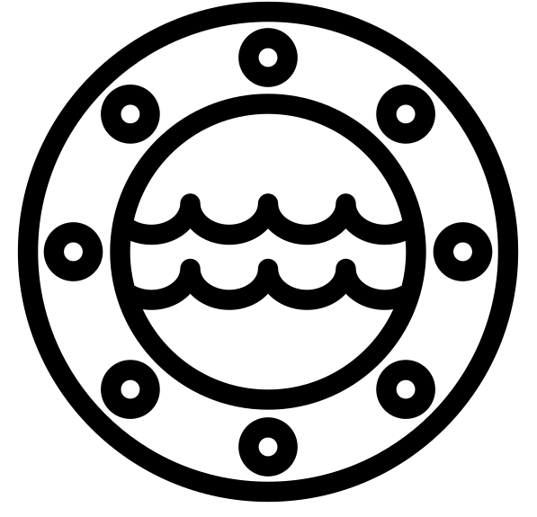





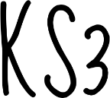
Key Stage 3 Learning Journey2025 – 26
Design and Technology & Food and cookery, Engineering
After choosing options in year 10, focus your studies in GCSE D&T, vocational food & cookery or Engineering in years 10 -11, through exciting, real life projects.
Deepen your understanding of these subjects in the world around us whilst developing products that help various needs and users. Real life scenarios and experiences.
FOOD & COOKERY
ENGINEERING
GCSE DESIGN & TECHNOLOGY
How it's assessed
40% of THE Vtec - Written exam: 1 h 45m
60% of GCSE - Non-exam assessment
Task 1: Recipe adaption
Task 2: 2 course meal – special diet
Task 3 – dessert for a food intolerance/ allergy
How it's assessed
Written exam: 2 hours
40%
2 Controlled assessment units
60% of GCSE
How it's assessed
Written exam: 2 hours
100 marks
50% of GCSE
Non-exam assessment (NEA): 30–35 hours approx.
100 marks
50% of GCSE
FABRICS
,FAHSION AND FURNISHINGS
PAPER & BOARDS
ICT
TIMBERS
METALS
POLYMERS
FOOD & COOKERY
Hospitality
YEAR
Vtec ENGINEERING
FASHION & TEXTILES
GRAPHICS PRODUCT
PRODUCT
DESIGN
10
KS4
OPTIONS
Evaluate:
How? What? Why?
Constraints/ limitations and possibilities?
Design:
Use surface decoration to design a personalised item for teens. Mood boards. Design developments.
Knowledge:
Exploring Macronutrients and Micronutrients, the impact on the health and wellbeing.
Design:
Adapting a standard recipe to make it meet dietary needs/ lifestyle choices
Make:
Continuing to refine skills in order to demonstrate confidence when cooking a variety of dishes: including presentation skills and side dishes (professional standards)
Make:
Decorate fabric, using sewing machine, produce a suitable end product
Evaluate:
Product, skills, progression, knowledge.
Materials:
Sustainable material focus. Natural fibres suitability
FOOD
How it can cause ill health, Nutrients
STEM
Science
Maths
Engineer
YEAR 9 ROTATION
TERM 1 SEPT – OCT
TERM 2 NOV – JAN
TERM 3 JAN – MAR
TERM 4 APR - MAY
TERM 5/6 JUNE - JULY
Maritime
Graphics – Perspective/ Isometric
Make:
Use a wide range of skills, materials and making skills. To develop high quality craftsmanship wind chime. Using CAD and CAM
Materials:
Working with hardwoods, metal, acrylic and specialist materials. Working properties and recognizing materials.
Evaluate:
What skills have you developed? Test your product and consider how you would improve it.
Design:
Practicing Isometric Projection and rendering skills. Orthographic projection.
Design:
Designing for families, outdoor space. How do we make a product fun, functional and safe?
Work in more depth on projects, honing your practical skills, improving your resilience & problem solving whilst developing independence in the workshop.
LAMP
MIXED MATERIALS
Design:
Use materials and industry techniques to produce a series of designs, showing development from concept to final product.
Knowledge:
What are the implications of not following the Eatwell guide, seasonal produce, food ethics, cost/ budget & culture/ religion.
Design:
Adapting recipes in order to meet the needs of a specific brief / customer need.
Make:
Using card, paper, plastic to create packaging and advertising materials for a fish restaurant.
Make:
Refine skills and develop new skills and make: a range of modified recipes to meet customers needs.
Evaluate:
How the moral consequences of food choice influences what we eat
Materials:
Develop a knowledge of sustainability within the promotional / marketing industry industry. Consider the environmemt.
YEAR
FOOD - Choices
Outside
Influences
Beat the chippy
9
Evaluate:
Sustainability impacting design. Product evaluation.
Evaluate:
Does your product work? How can you fix problems?
Design:
Designing for a user and client. What is an isometric projection? Develop design ideas using 2D Design.
KEEP CALM
RETRIEVAL
MAKES
PERMANENT
Graphics
Maritime packaging
Make:
Vacuum Forming & Vinyl Cutter, CAD Laser cutting
Materials:
Polymers Classification.
What is a polymer?
Manmade materials
Regenerated materials
What is a charity? RNLI
Wind powered
BOAT
PROJECT
YEAR 8 ROTATION
TERM 1 SEPT – DEC
TERM 2 JAN – APR
TERM 3 MAY - JUL
Design:
Following recipes and adapting them to meet your preferences, looking at dietary needs
RM
Skills
Work in more depth on projects, honing your practical skills, improving your resilience & problem solving whilst developing independence in the workshop.
Make:
Use different methods to decorate fabric, develop sewing machine skills and produce a working product.
Evaluate:
Does your product work? ACCESS FM. How can you fix problems?
Knowledge:
Health and Safety in the Kitchen.
The Eatwell Guide, 8 tips for healthy living.
Make:
Beginning to use kitchen equipment to make; a range of nutritious recipe.
Design:
Use industry methods to produce a range of designs suited to the brief.
FOOD
Healthy eating
PROJECTs
A fishy tail! recipe
YEAR
8
Materials:
An introduction to fabrics
TOP TIPS
Evaluate:
How successful we my products? Did they meet the brief?
YEAR 7 ROTATION
TERM 1 SEPT – DEC
TERM 2 JAN – APR
TERM 3 MAY – JUNE
SHORT PROJECT - JULY
TEXTILES
Monsters PROJECT
Aesthetics Cost Customer Environment
Safety Size Function Material
SHORT 5 WEEK PROJECT
YEAR
Experience a wide range of fun and exciting projects that teach you valuable skills in the workshop, understanding different materials and how they work.
RSPB - Birdhouse
PROJECT
7
Evaluate:
What makes a good Birdhouse? How can you improve / modify your design?
Design:
Design development of the Birdhouse Identifying problems and creating solutions
Make:
Wood joints
Use of hand tools and machines
Materials:
Wood classification. Where does timber come from?
Introduction to the workshop:
Health and Safety
What is a charity?
Baseline Assessment:
What do you already know about DT?

