Slide 1
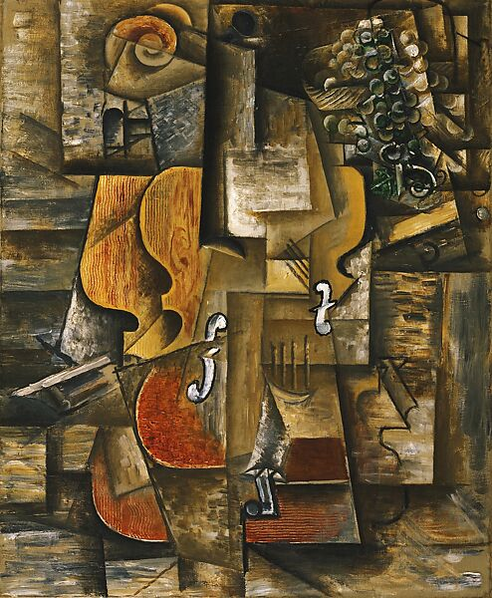
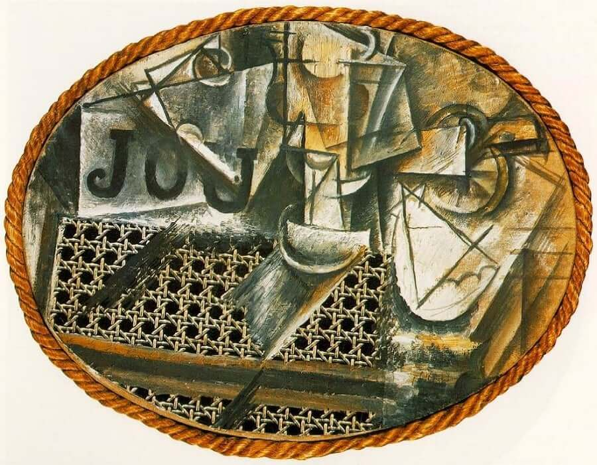
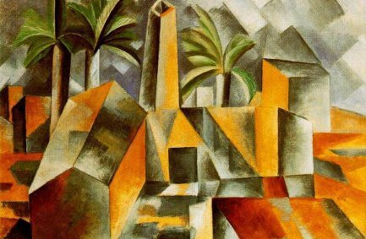
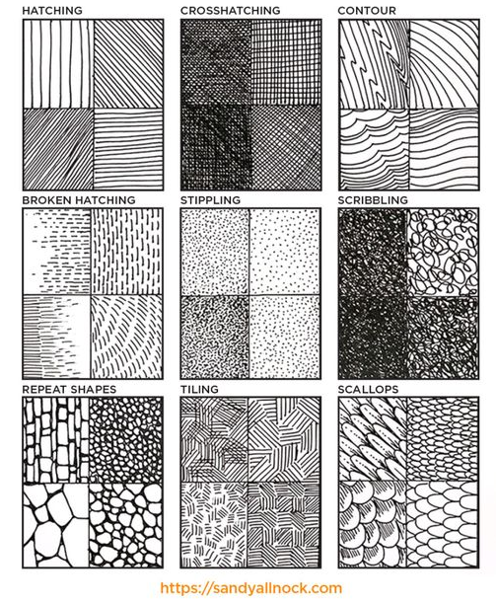
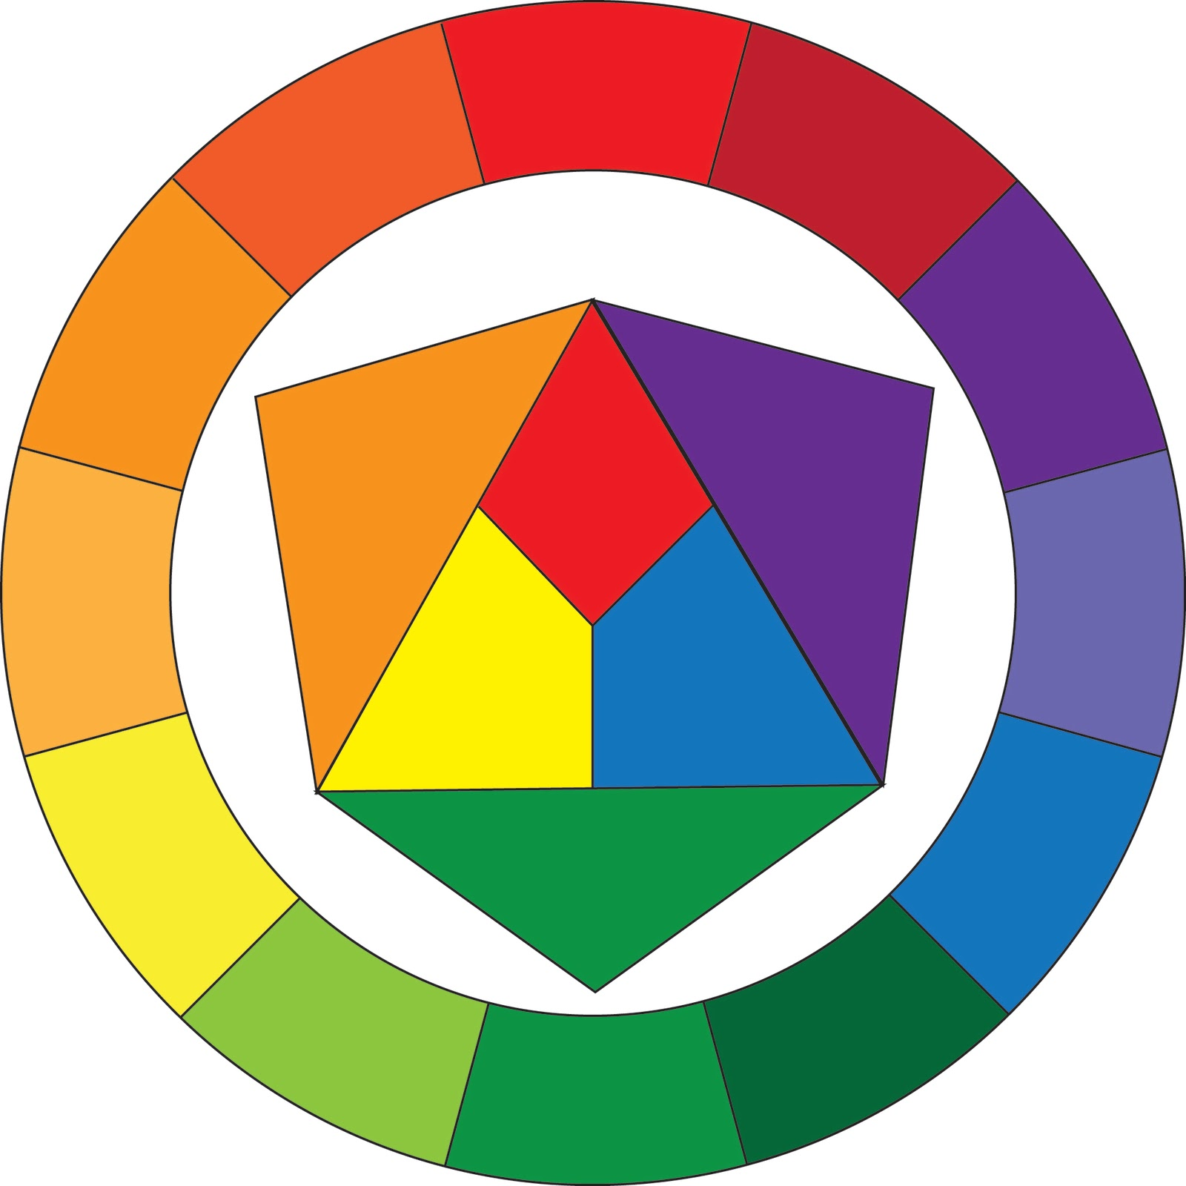
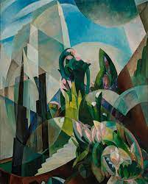
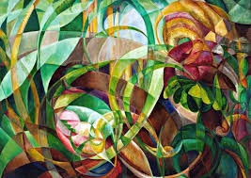

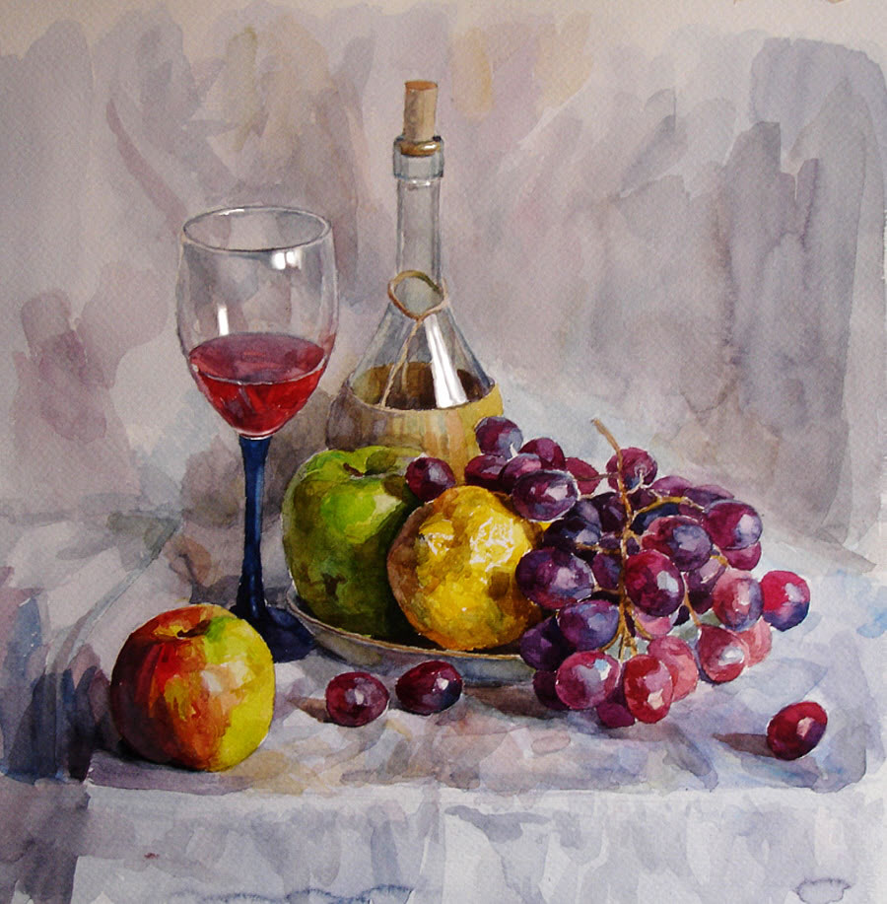
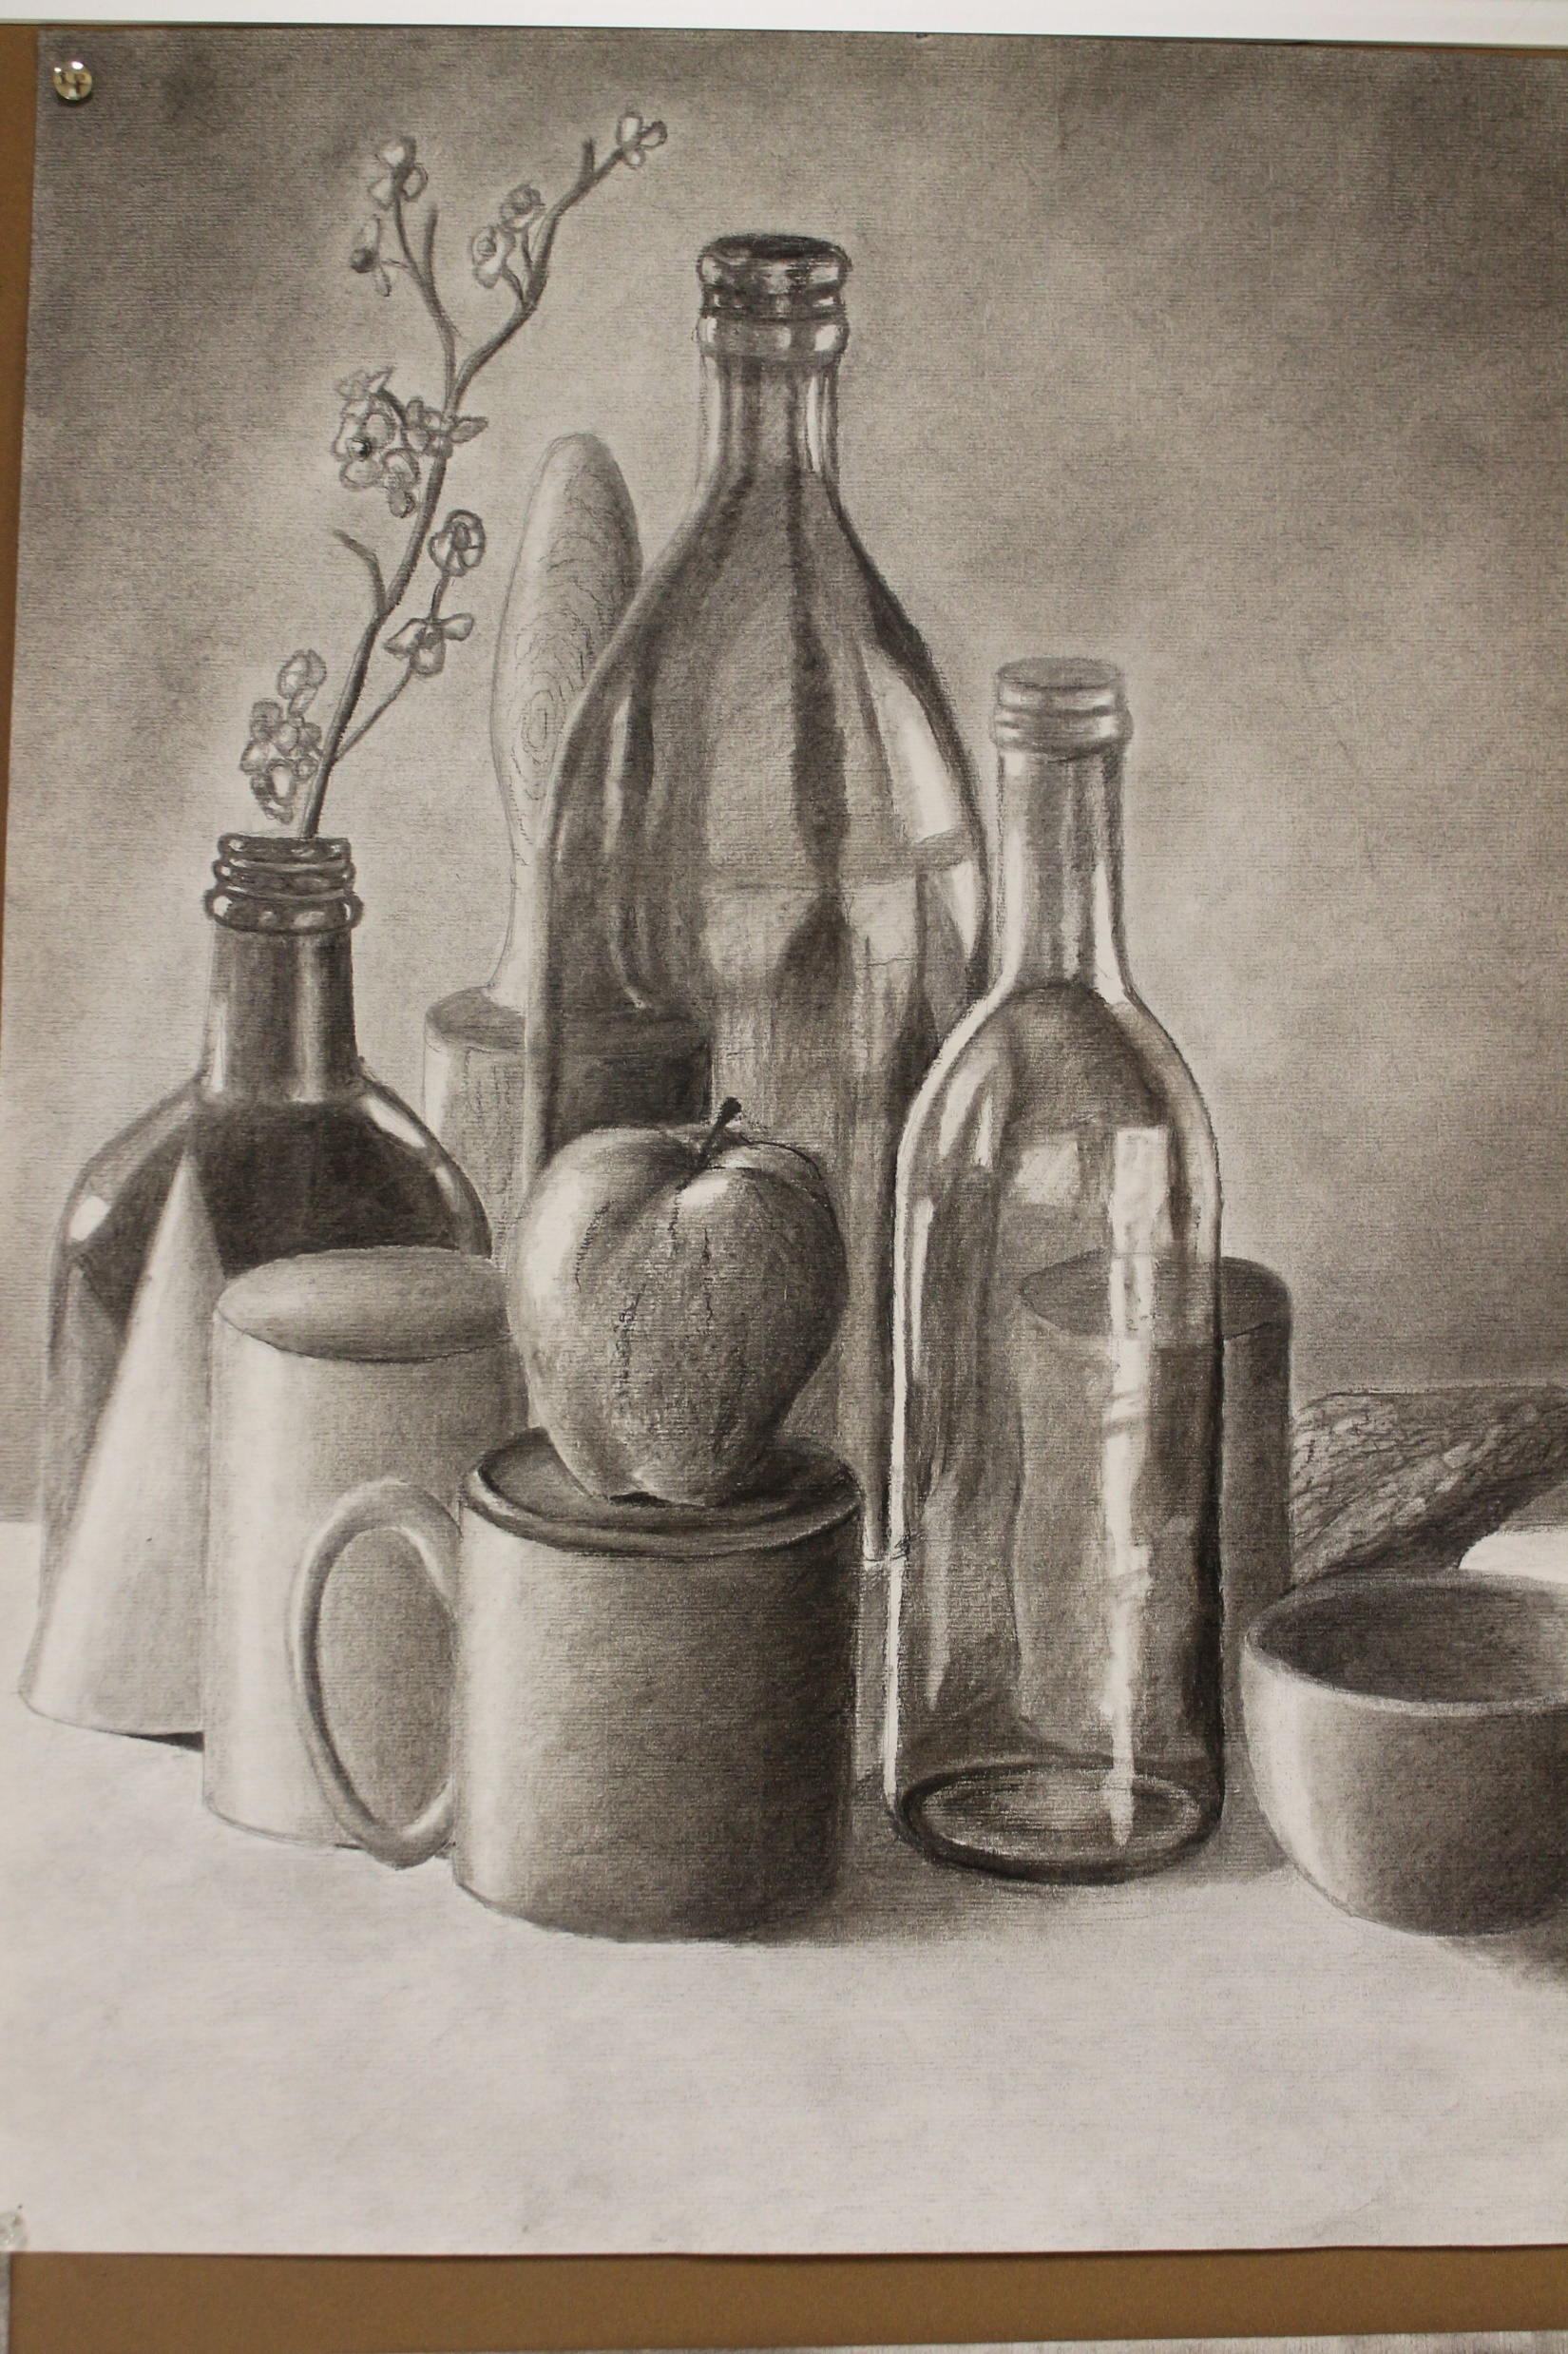
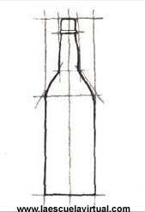
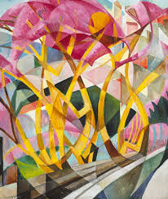
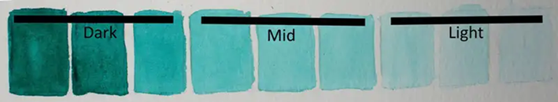
Art – Knowledge Organiser – Year 9 ‘The Basics’
Drawing –
Tone – How dark or light areas are. A good drawing will have the full range of ‘tones’ from very dark/black, to very light / white.
Tints- Adding white to a colour to make it lighter.
Shade – Adding black to a colour to make it darker.
Shading – A technique where different tones are added to make an image look more realistic.
Grey Scale- The squares on the left are an example of grey scale.
3 Dimensional / 3D Drawing; an image that has the appearance of being solid or has depth rather than being flat. Composition- The layout of an image, where things are in a picture.
Still Life – An image made up of a group of objects arranged in an interesting way.
Composition – Layout of the imagery on your page – Use of space.
Mark Making
Picasso - Cubism
Colour-
Primary – Red, Blue & Yellow; They are used to make all the other colours.
Secondary- Purple, Green & Orange. Made by mixing two Primary Colours.
Tertiary – Made by mixing a Primary & a Secondary Colour together.
Monochrome – One colour in different shades
Complementary – Two colours opposite on the colour wheel that make each other look more vibrant when they are together.
Mary Swanzee

