Slide 1
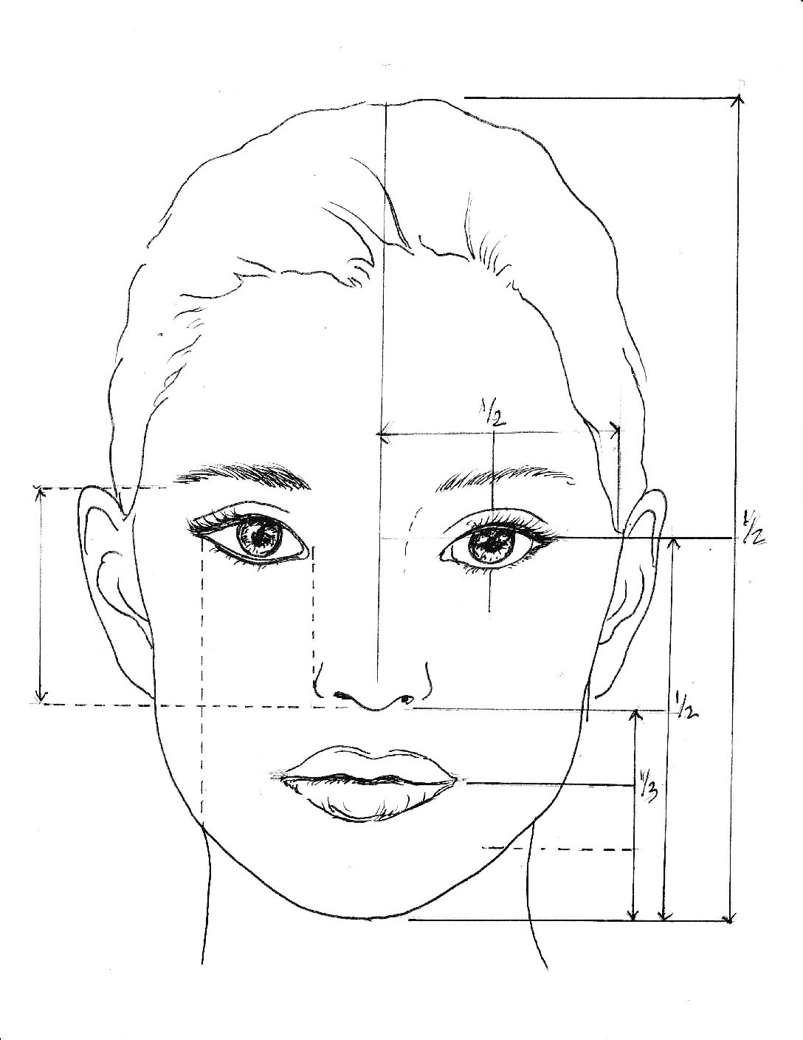
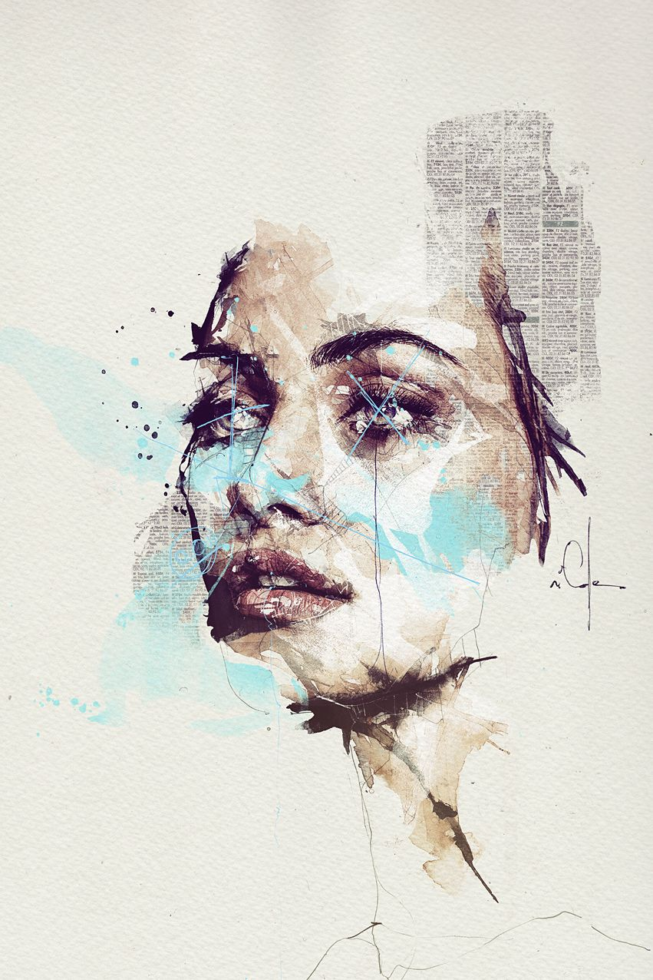
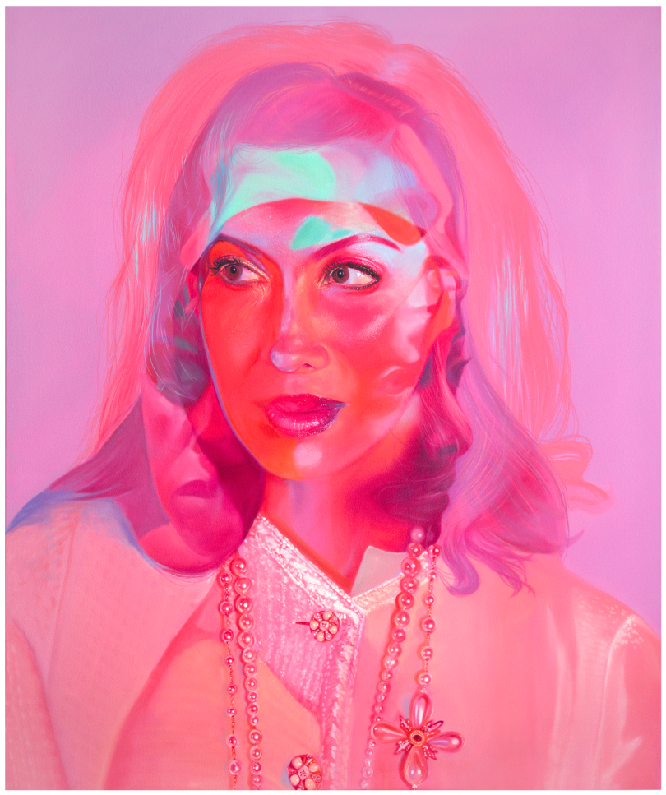
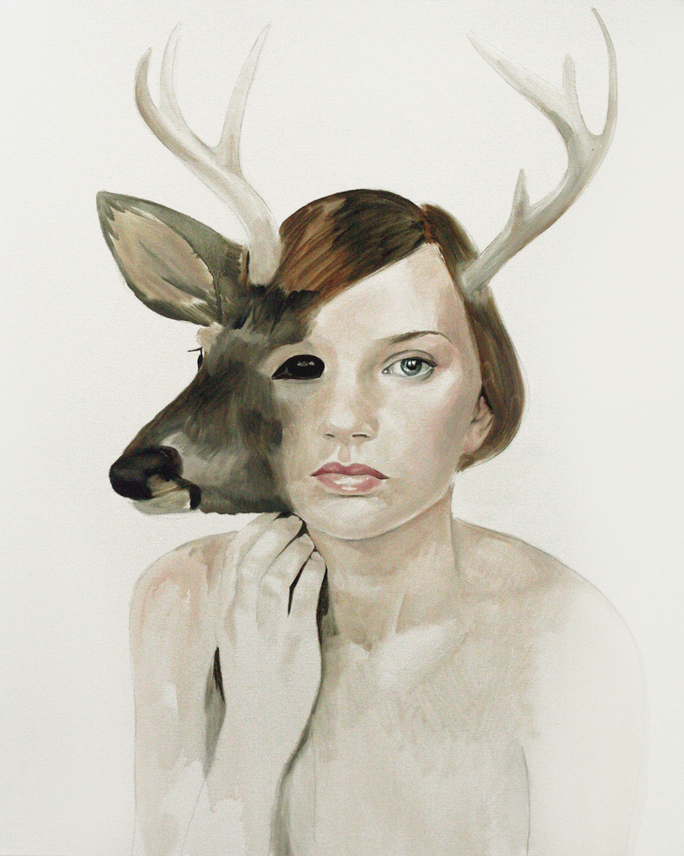
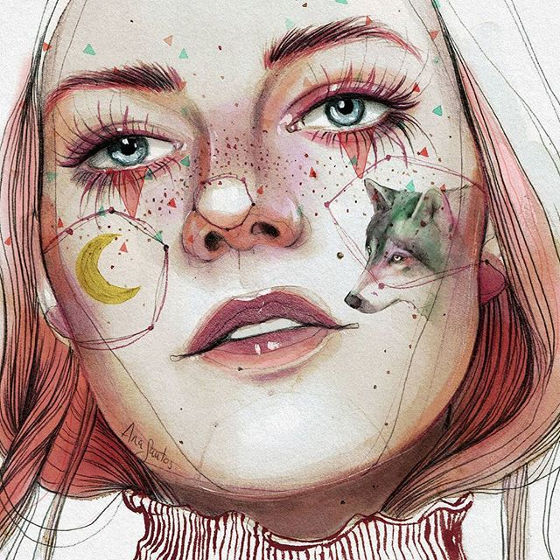
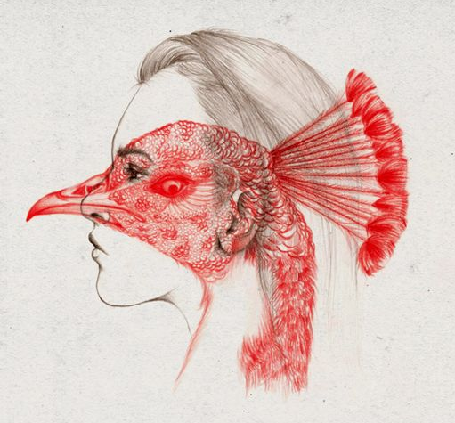
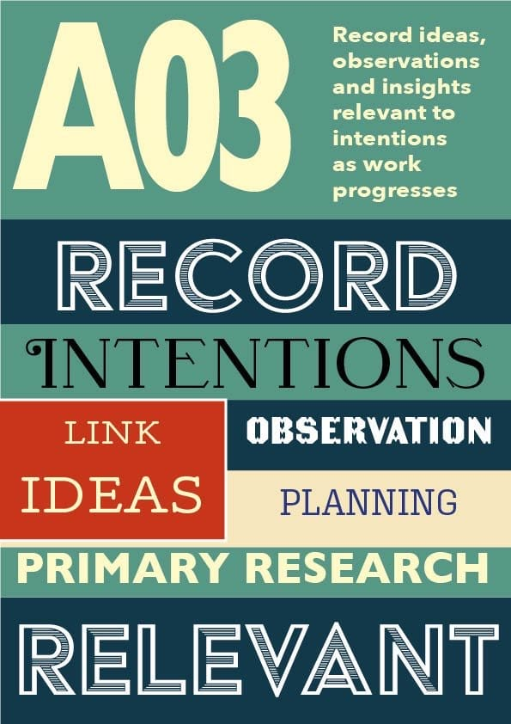
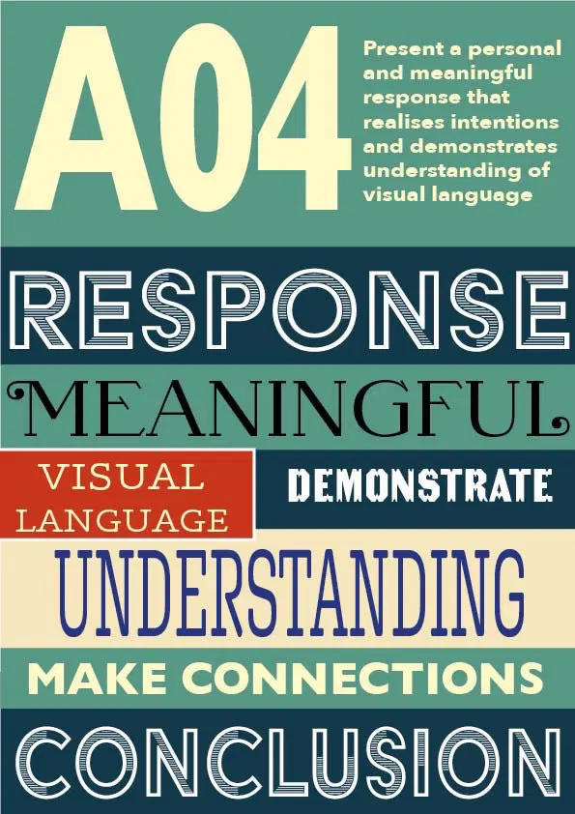

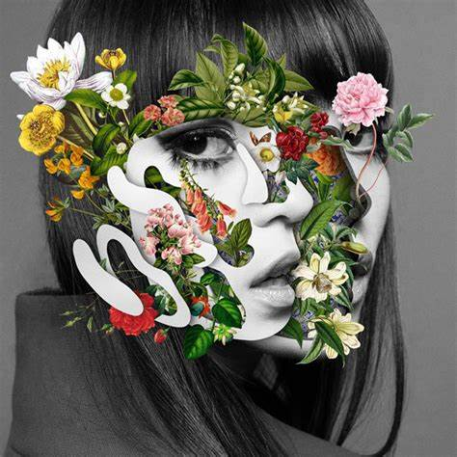

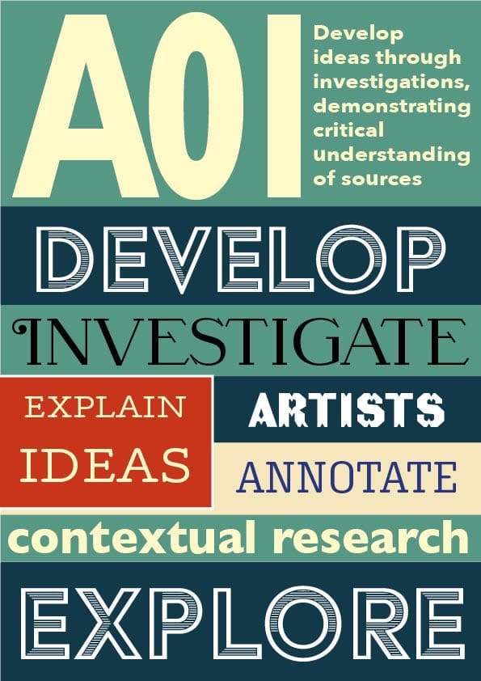
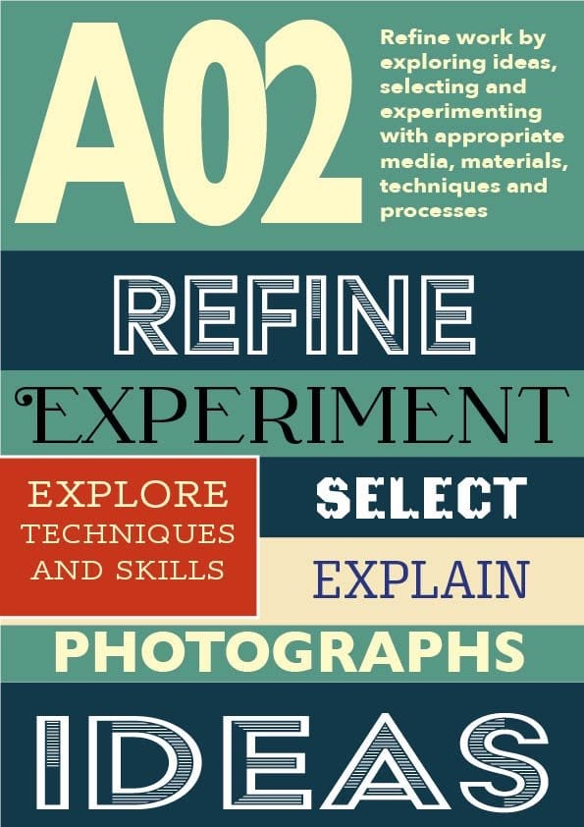
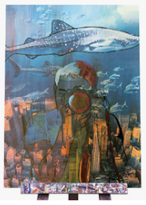
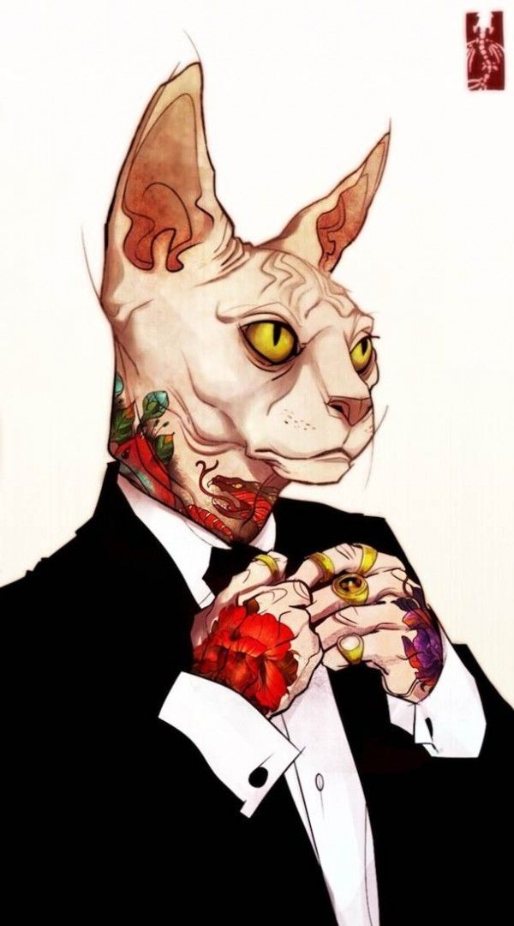
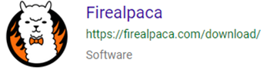
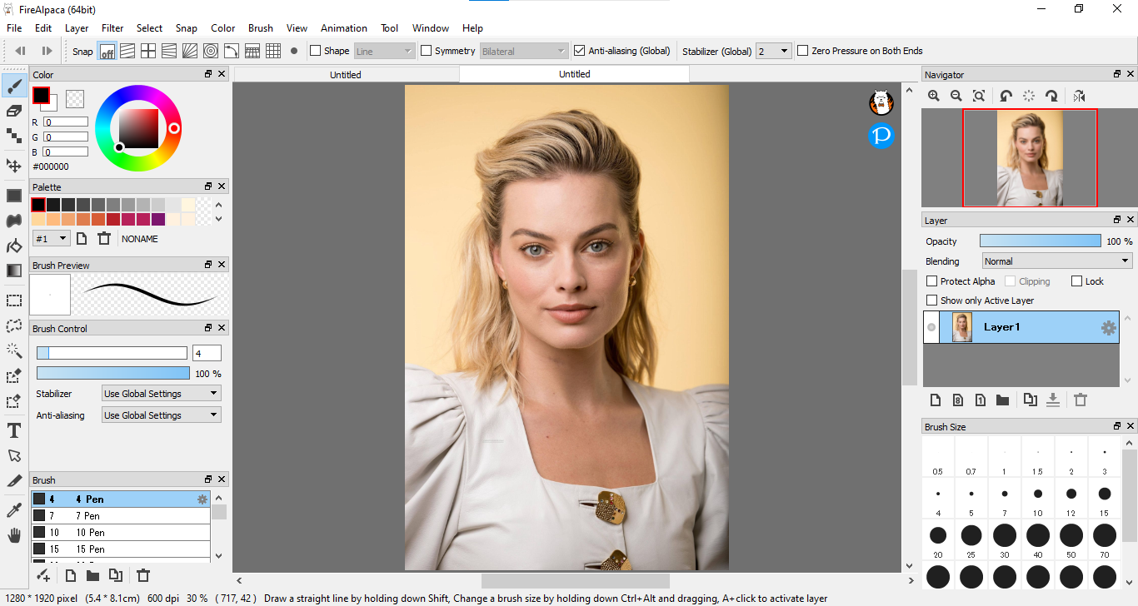
Fine Art 8202 GCSE – Knowledge Organiser – Year 10 ‘Hybrid’
Portrait in Proportion:
Draw an oval
Using the measurements shown, everything in your face has it’s place and can be measured.
Eyes = ½ way
Nose ½ way between eyes and chin
Eyes fit 5 times into your face.
Nose is the width of your eye.
Adapting your work to present a concept.
AQA | GCSE | Art and Design | Specification at a glance
Artists covered:
Florian Nicolle
Jenn Mann
Ana Santos
Peony Yip
Marcel Monreal
Kim Nguyen
FireAlpaca is a free Digital Painting software that is compatible with both Mac and Windows. It works in a very similar way to Photoshop. This will be used during the GCSE course.
This will be taught during the course however tutorials are available, particularly on Youtube.

