Slide 1

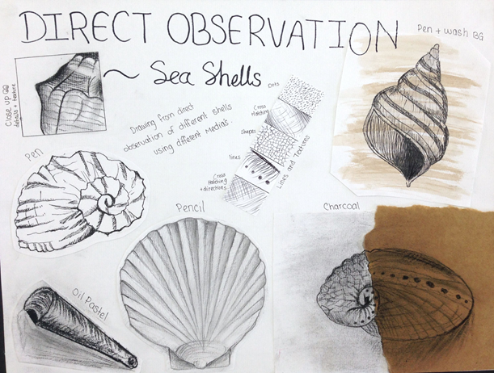
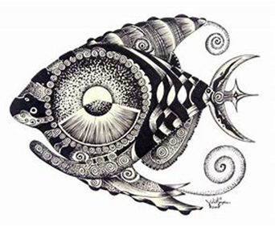
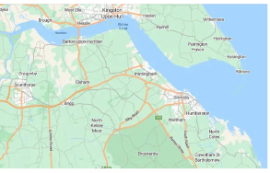
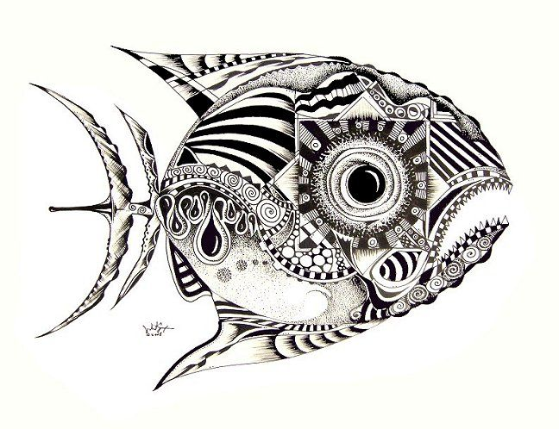
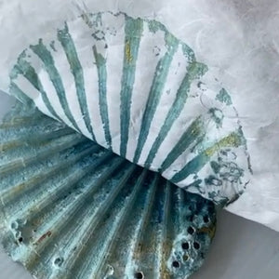
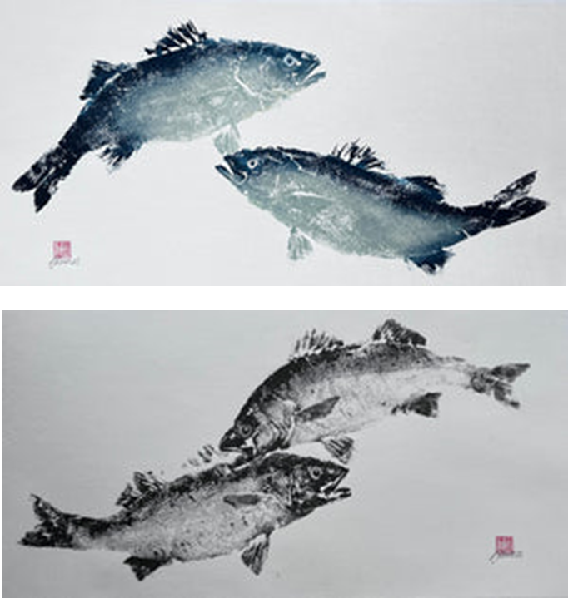
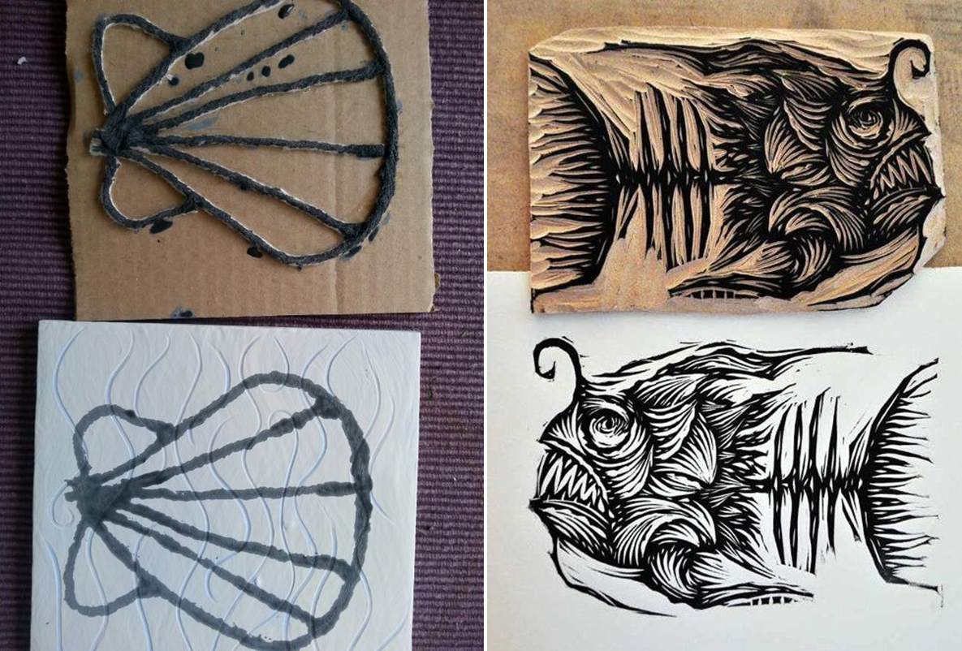
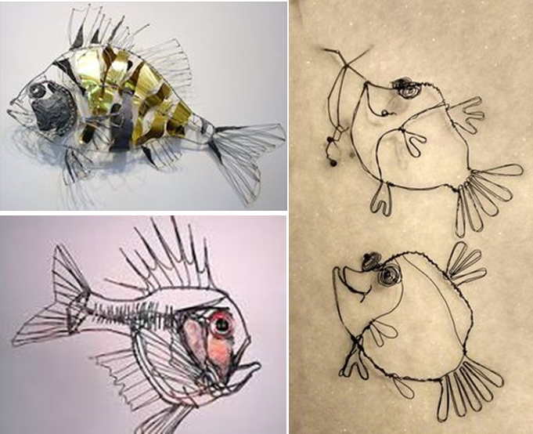
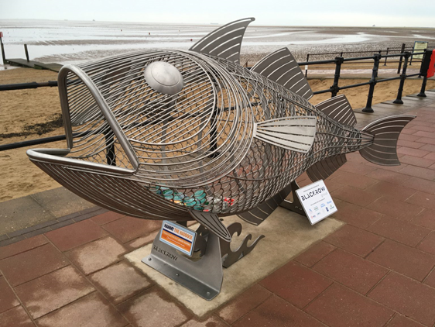
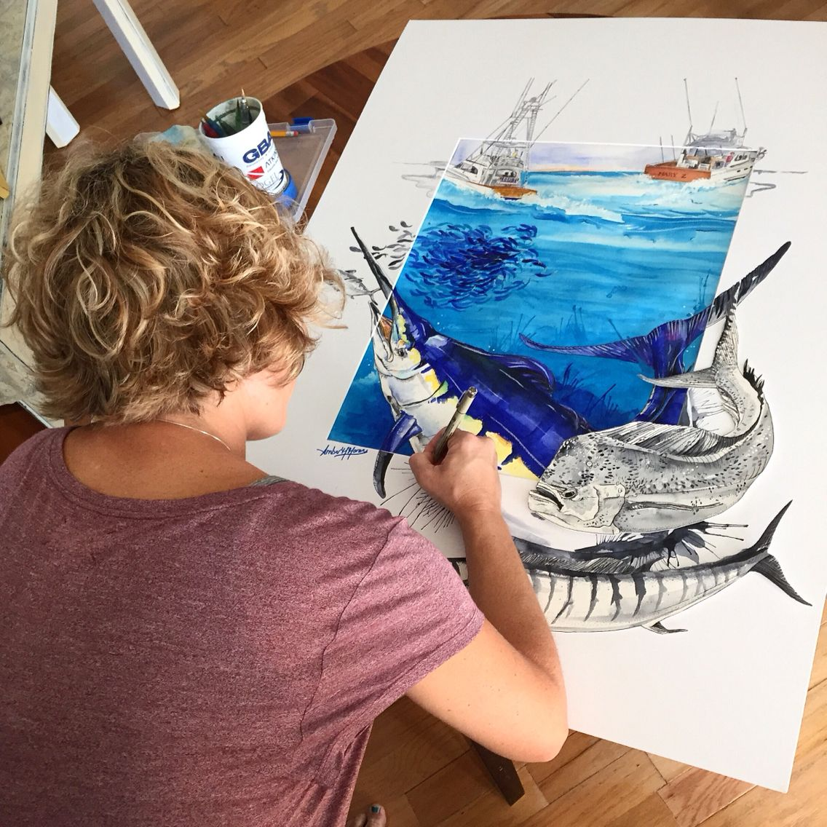
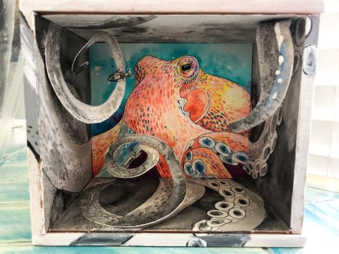
Art – Knowledge Organiser Term 4&5 – Year 8 ‘Maritime Futures’
Techniques:
Polyboard printing
Lino printing
Pen wash
Blending
Painting
Cross-hatching
Wire modelling
Card modelling
Media:
Pen
Water-colour paint
Printing inks
Wire
Card
Gyotaku
Japanese art of printing fish.
Artists covered:
Vincent J Scarpace
Amber Moran

Slide 2
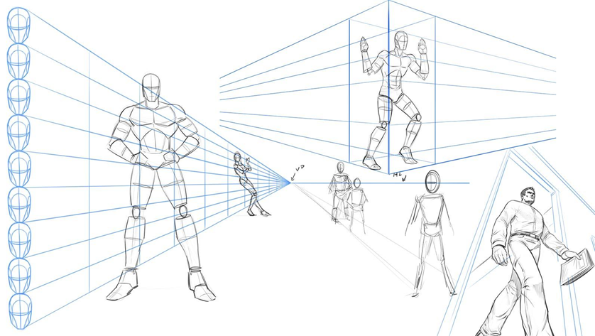
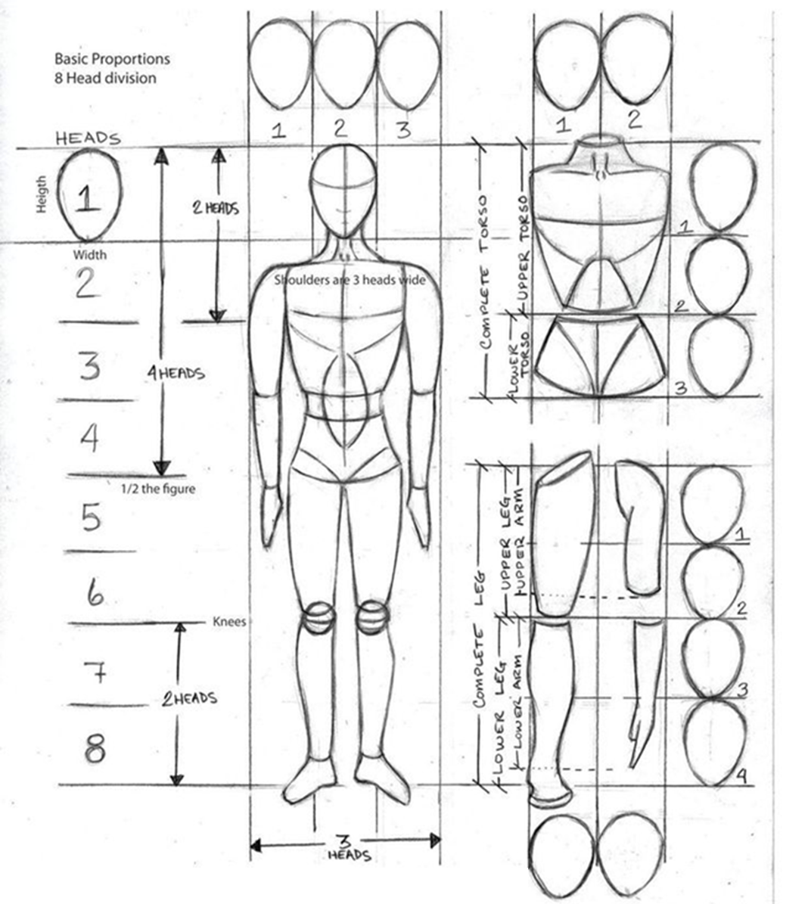
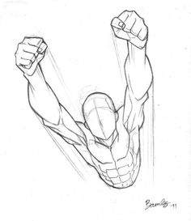
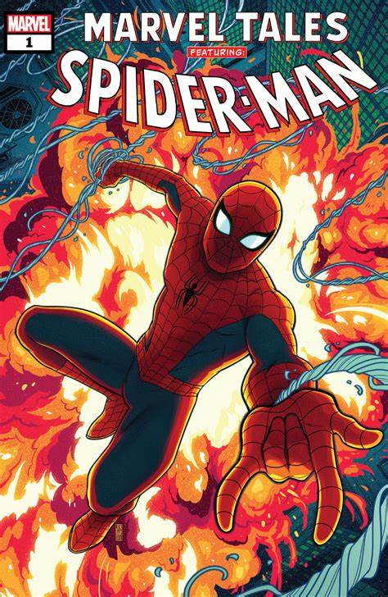
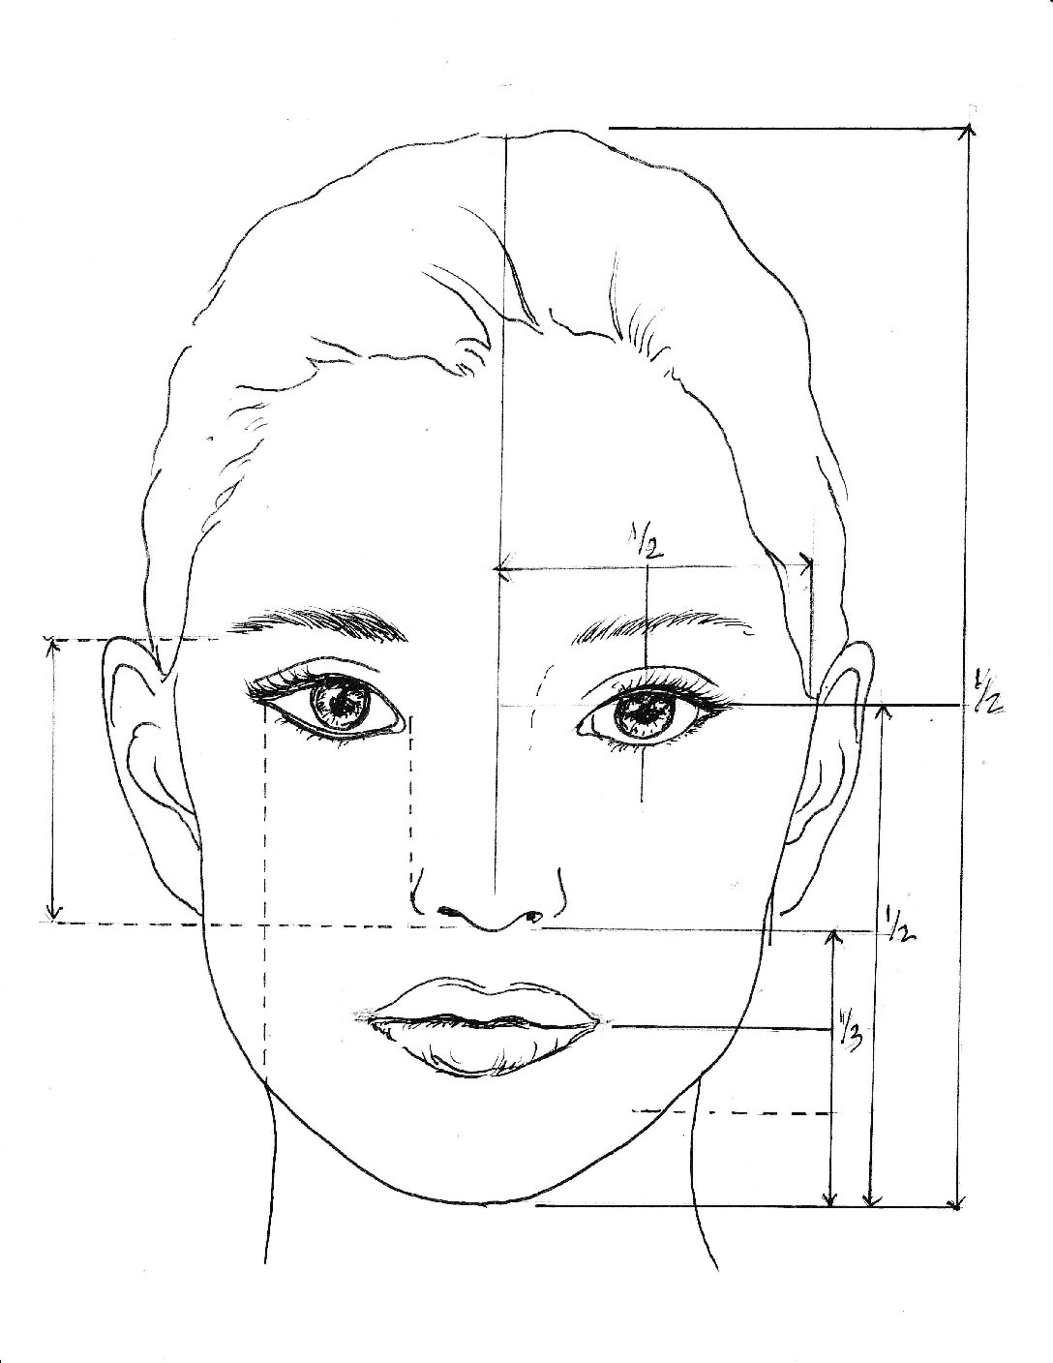
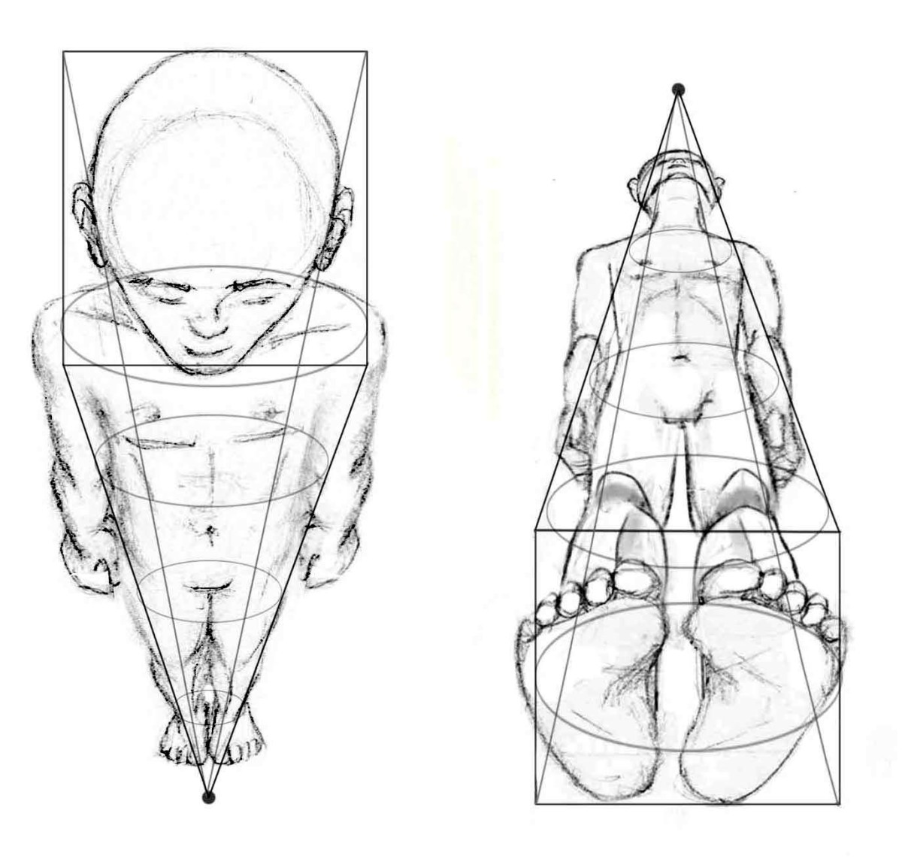
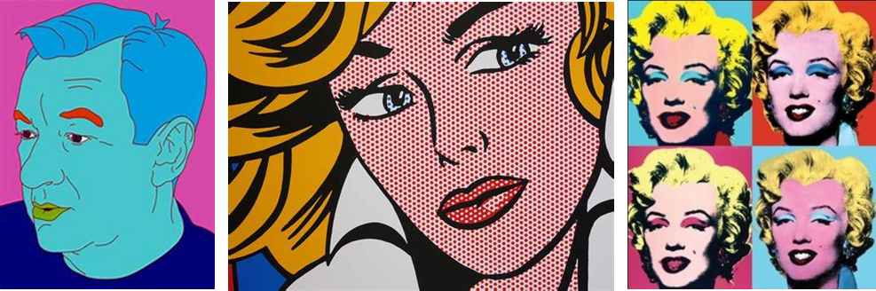
Art – Knowledge Organiser Term 6– Year 8 ‘Portraits and the human figure’
Foreshortening gives the impression of perspective and depth, as the object is coming towards you.
Portrait in Proportion:
Draw an oval
Using the measurements shown, everything in your face has it’s place and can be measured.
Eyes = ½ way
Nose ½ way between eyes and chin
Eyes fit 5 times into your face.
Nose is the width of your eye.
Artists covered:
Michael Craig Martin
Andy Warhol
Roy Lichtenstein
Using Human proportions and foreshortening to produce an action comic figure cover.

