Slide 1
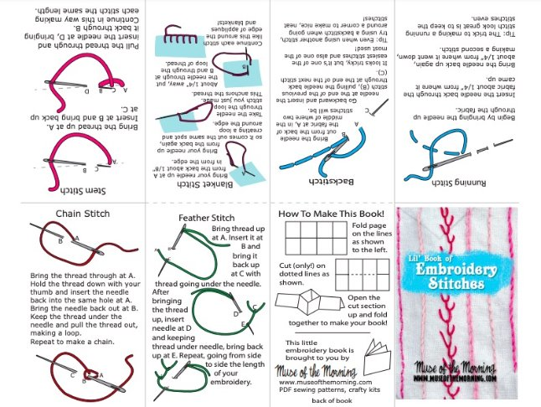

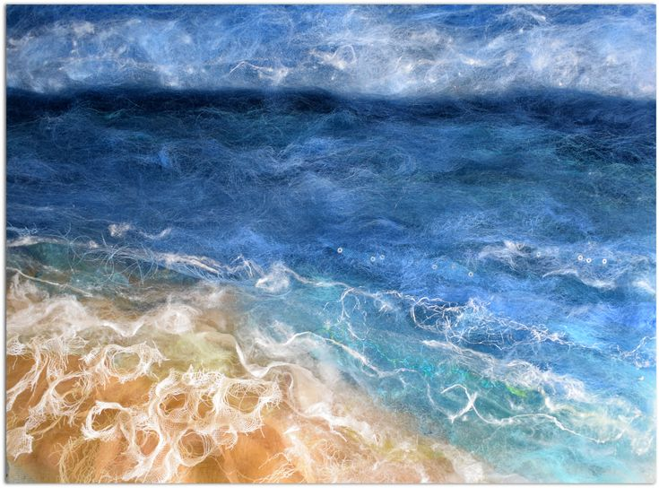
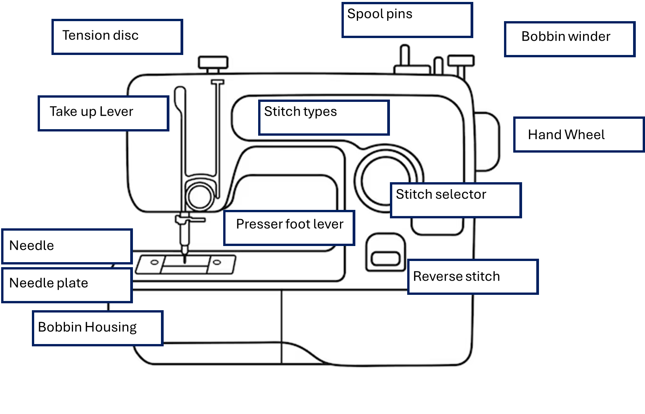
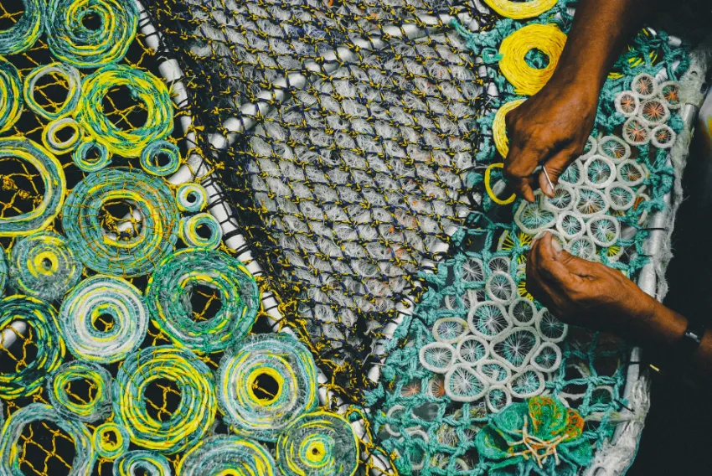
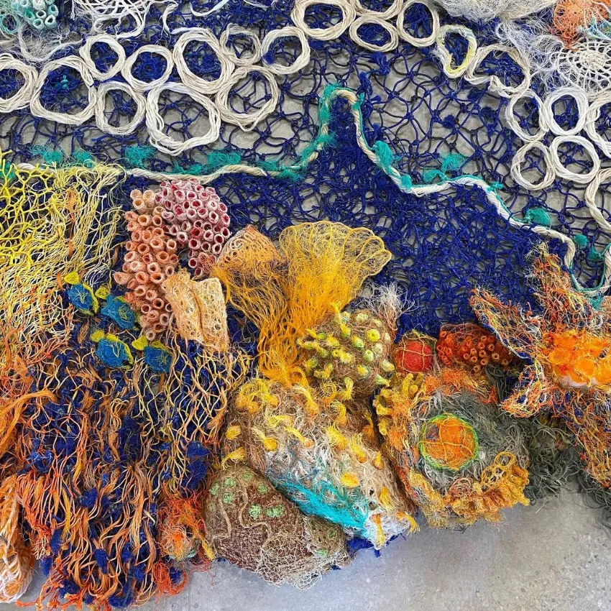
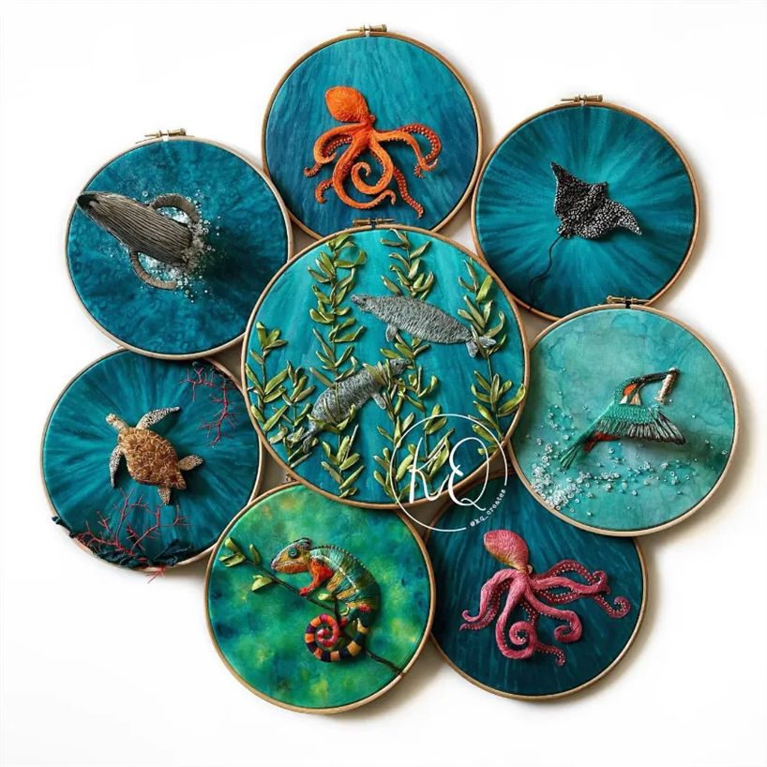
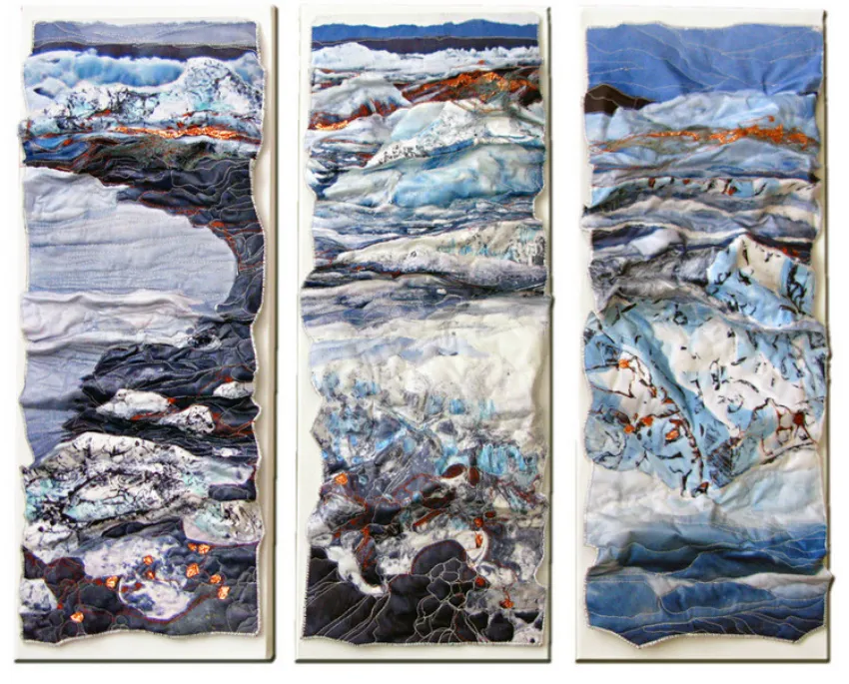
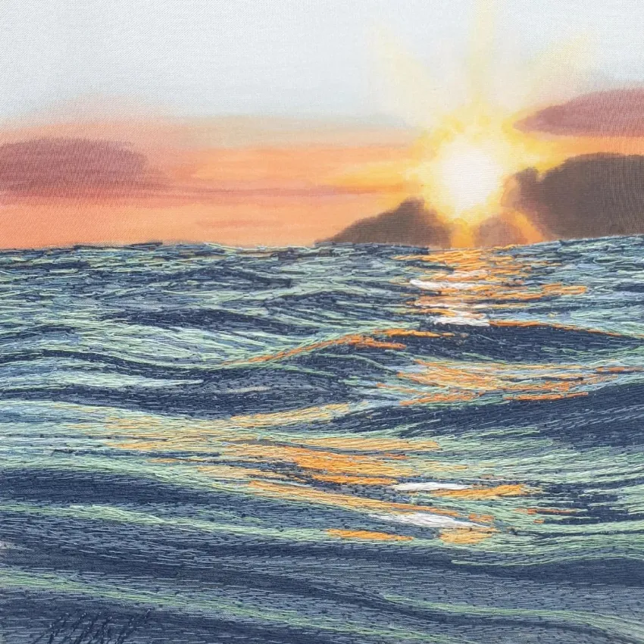
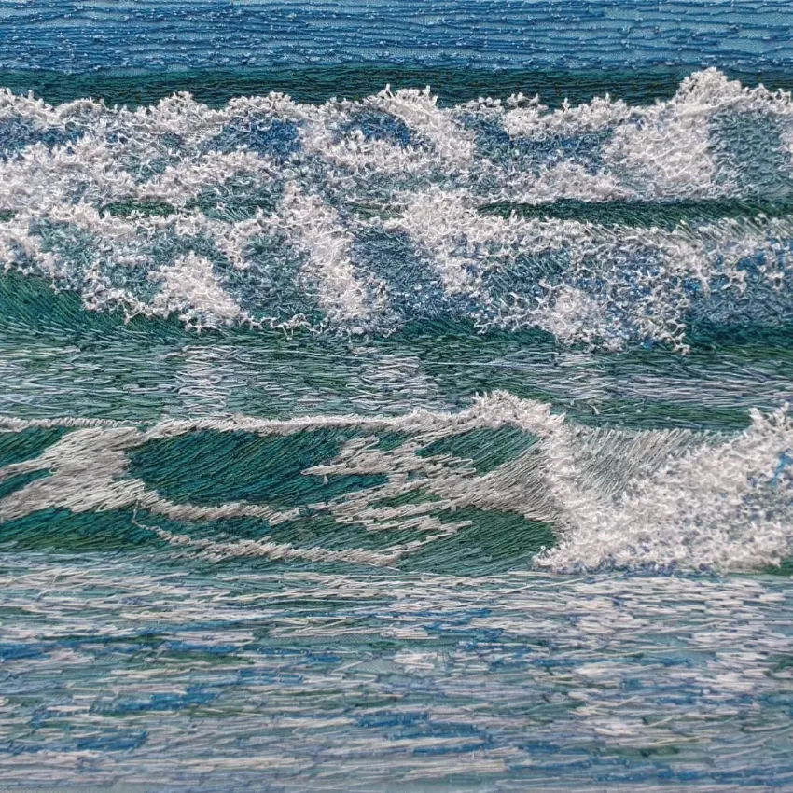
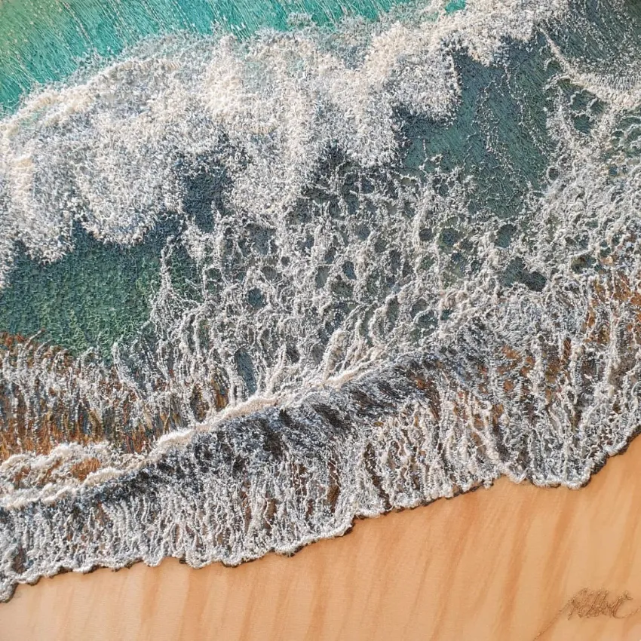
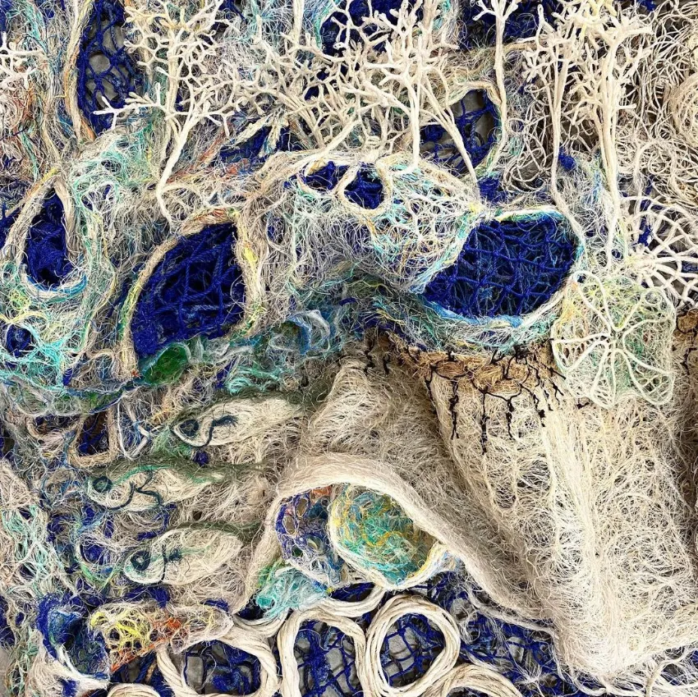
Art – Knowledge Organiser Term 4&5– Year 9 ‘Maritime – Art Textiles’
Katherine KQ creates
Lynnette Griffiths
& Erub Arts
What is ‘Textiles art’?
Textiles art is producing using a variety of fabrics to create an image. Textiles art can be produced wither by hand or machine. Textiles brings a new dimension of texture to your art and allows to add a further dimension to your drawing and painting,
Key Terms:
Wet Felting
Free Machine Embroidery
Hand Embroidery
Macrame
Sewing Machine
Applique
Sandra Meech
Alison Holt

Slide 2
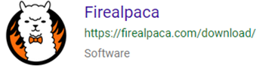
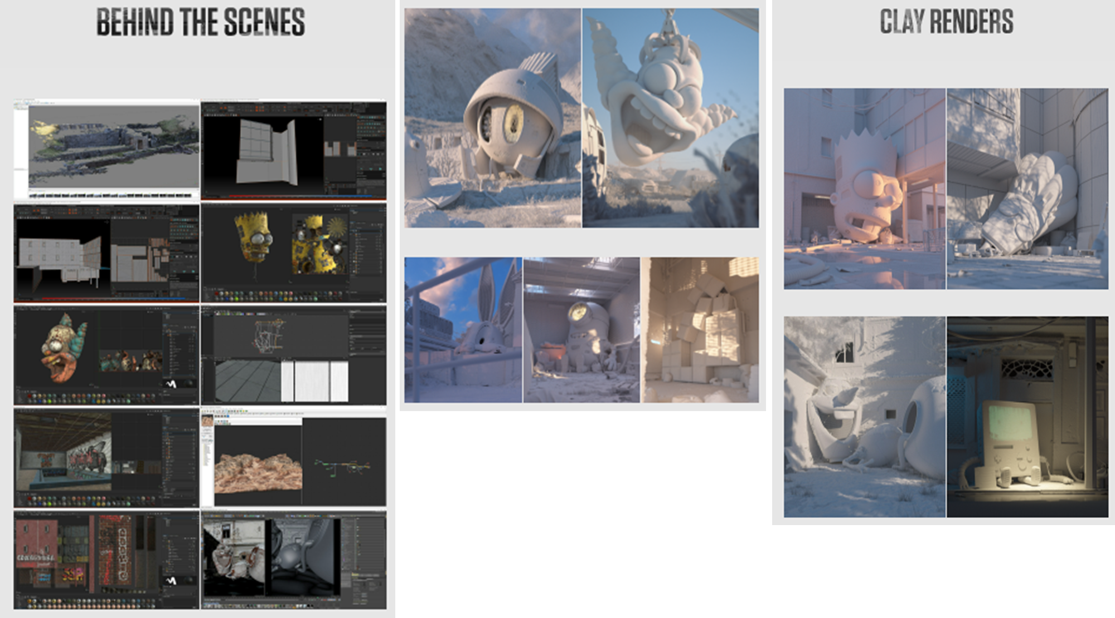
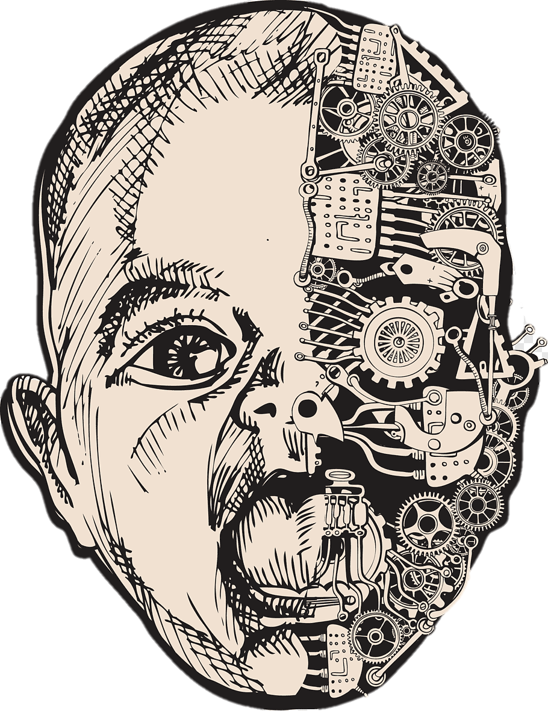
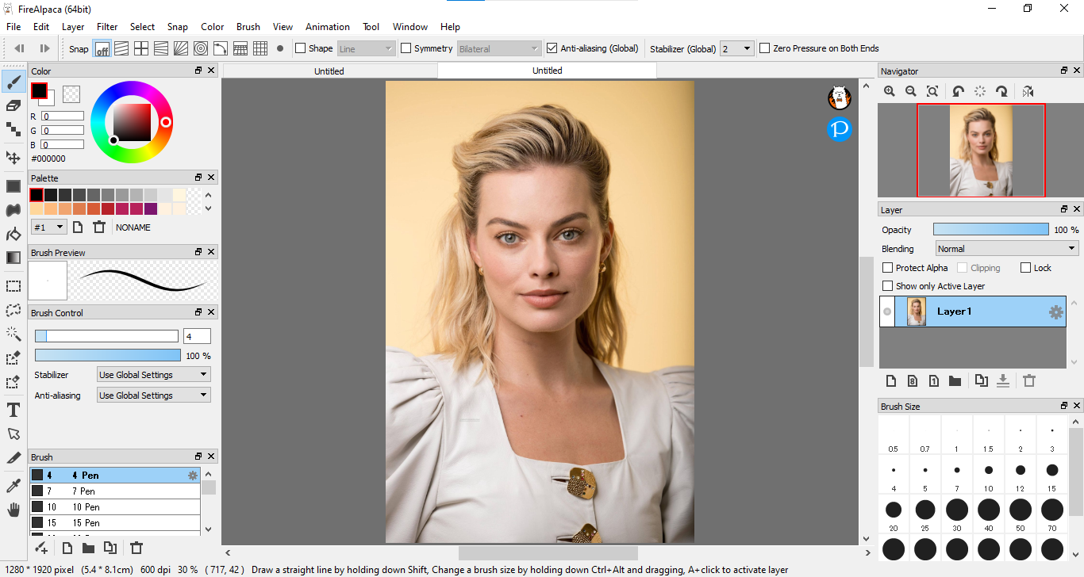
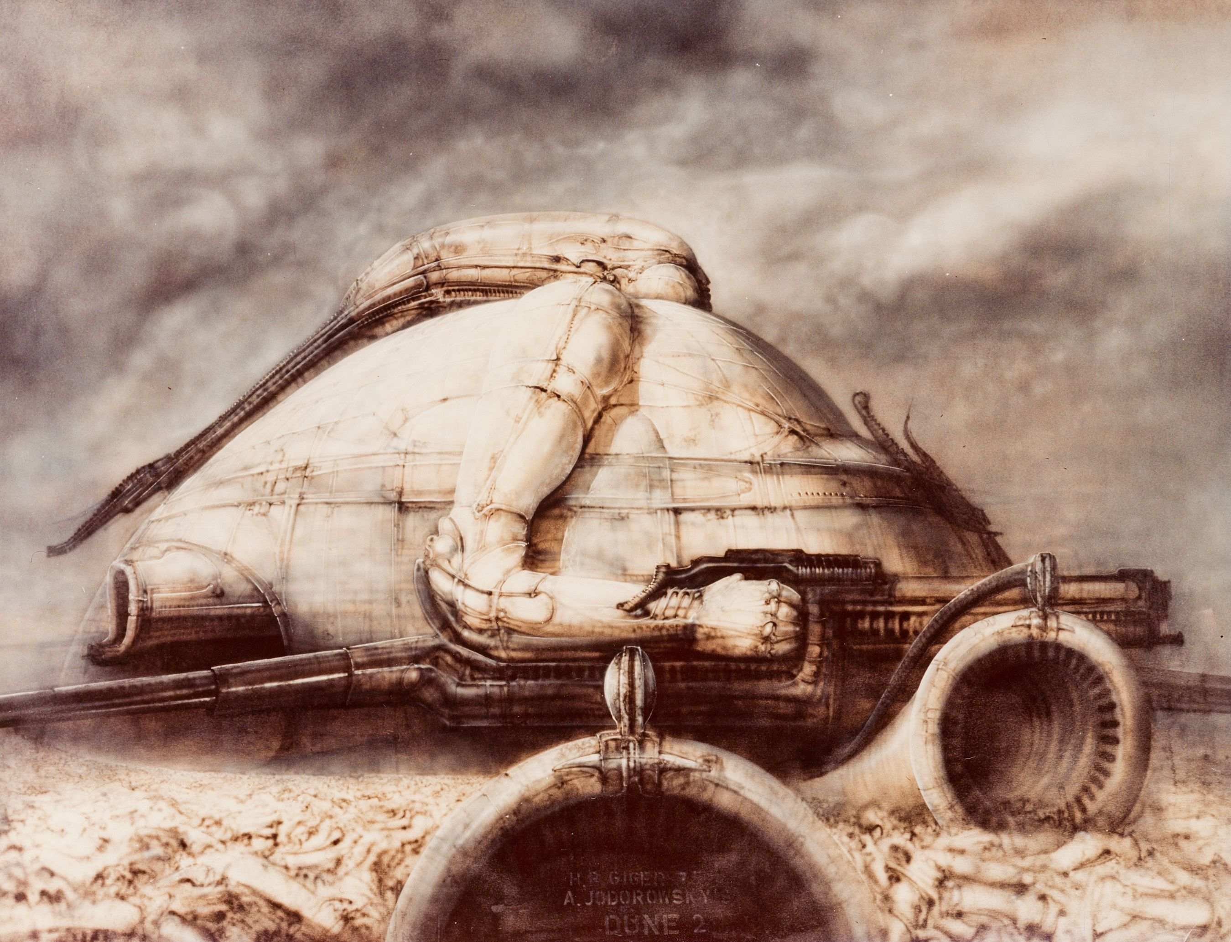
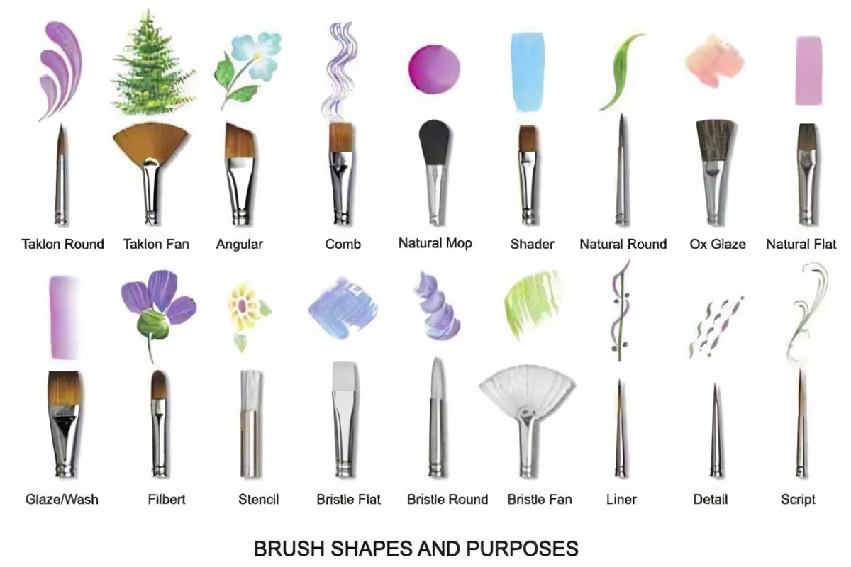
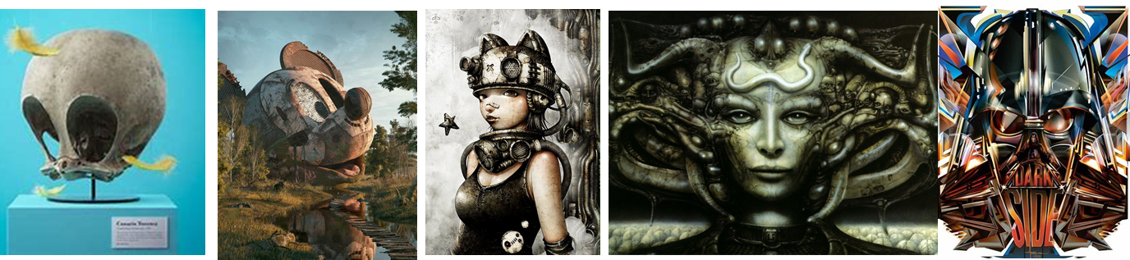
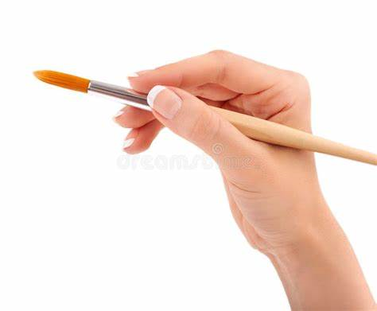
Art – Knowledge Organiser Term 6– Year 9 ‘Concept Art’
Working in layers to produce a concept – How the professionals do it digitally.
FireAlpaca
is a free Digital Painting software that is compatible with both Mac and Windows. It works in a very similar way to Photoshop. This will be used during the GCSE course.
This will be taught during the course however tutorials are available, particularly on YouTube.
What is concept art?
Concept Art is essentially the visual representation of an idea before it is developed into a final product. It is used in various industries to define the look and feel of a product, movie, video game, or animation before it is produced. Concept Art provides a tangible, visual blueprint,
Artists covered:
Filip Hodas, Schichigoro Shingo, HR Giger, Orlando Arocena

